Slide 1
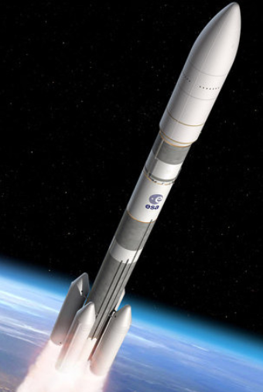
Dynamic analysis of a reusable launcher
Student: Naomi LUGLIO – Double Degree Student Politecnico di Torino and ISAE-SUPAERO
Tutor: Joseph MORLIER – ISAE-SUPAERO - DMSM
Tutor: Laurent BEAUREGARD–ISAE-SUPAERO - DCAS

Slide 2
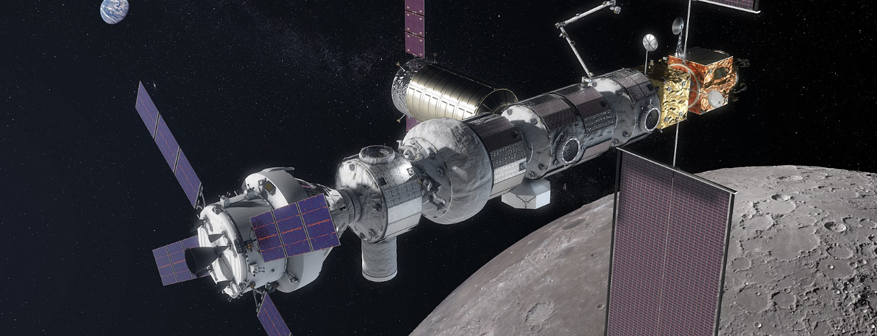
Why a dynamic study of a reusable launcher
An ambitious project:
Lunar Orbital Platform Gateway

Slide 3









Contents
Why a dynamic study
Problem Statement & Past Researches
1D Refined Model Theory:
Hypothesis
Derivation of nuclei matrices
Assembly procedure
Reduction of the dynamic analysis to an eigenvalue problem
Advantages of 1D Refined Model:
Lagrange & Taylor Expansion
Convergence Analysis
Thin-walled beam Application
Launcher Application
Conclusions
References

Slide 4


Problem Statement:
Reference solution:
to get enough precise results with a lower number of DOFs.
to have a medium fidelity tool for preliminary dimensioning
1D Refined Method solution:
1D Refined Model[4] Carrera, 2003 [5] Carrera,2011

Slide 5

Theory…

Slide 6




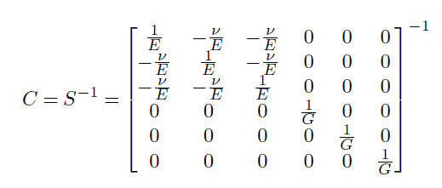
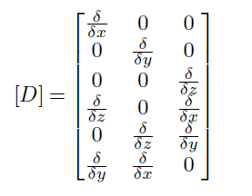

1 . 1D Refined Model
Hooke’s law:
Linear strain-displacement relations are used:
$$ε=\left[D\right]u$$

Slide 7
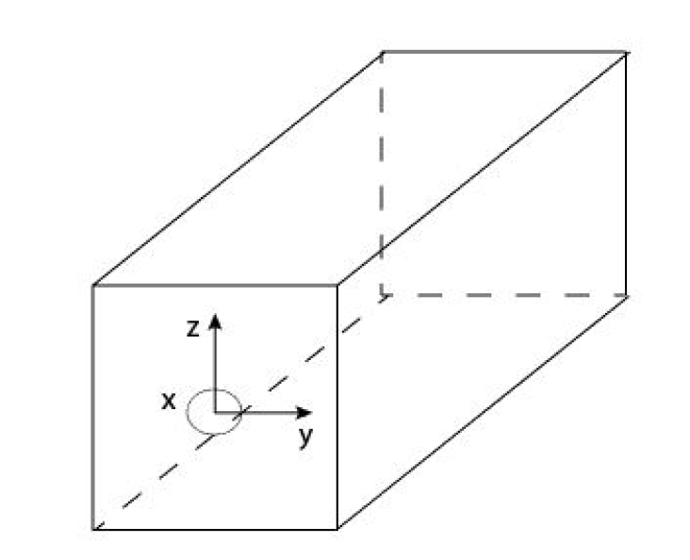





2. 1D Refined Model
CUF’s hypothesis
FEM’s hypothesis
PVD’s equation
_{Fig 1: Used reference system}

Slide 8



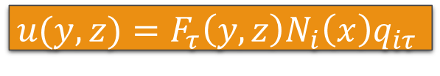
3. 1D Refined Model
$$u(y,z)=F_{τ}\left(y,z\right)N_{i}\left(x\right)q_{iτ}$$

Slide 9
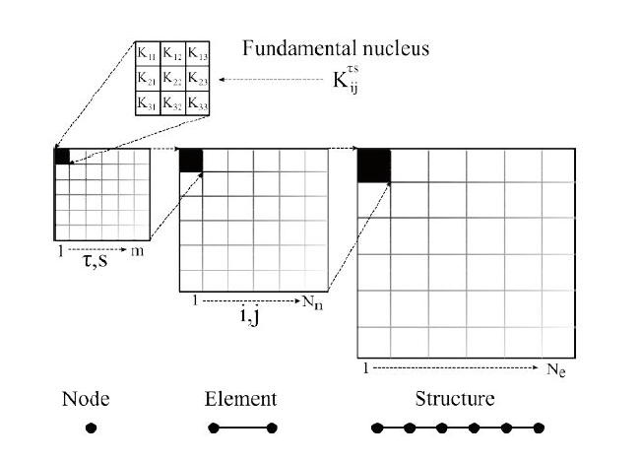


4. 1D Refined Model
Fig 2: Assembling procedure for the stiffness matrix of a 1D refined model ^{[6]Carrera, 2014}

Slide 10
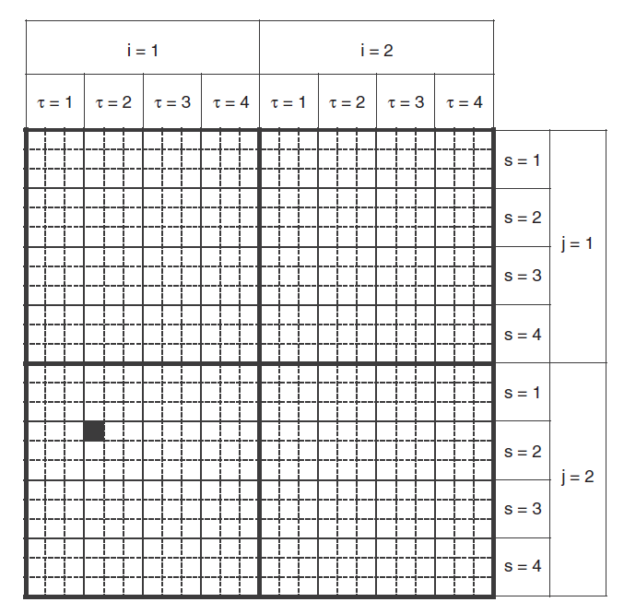
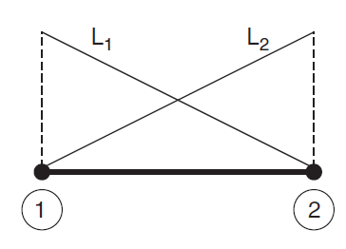

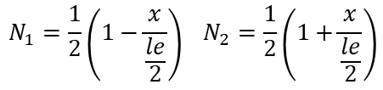
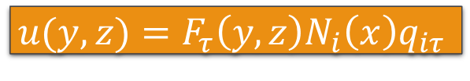
5. 1D Refined Model
$$u(y,z)=F_{τ}\left(y,z\right)N_{i}\left(x\right)q_{iτ}$$
Example:
-Beam element with two nodes
$$N_{1}=\frac{1}{2}\left(1−\frac{x}{\frac{le}{2}}\right) N_{2}=\frac{1}{2}\left(1+\frac{x}{\frac{le}{2}}\right)$$
- $F_{τ}\left(y,z\right)$expression over the cross-section with M=4 terms
Fig 3: Stiffness Matrix of a Beam element with 2 longitudinal nodes (bnod2) and M=4 ^{[6]Carrera, 2014}

Slide 11
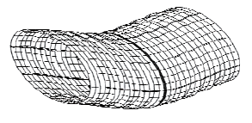
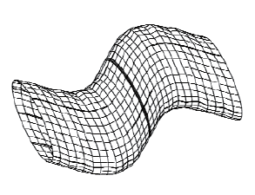

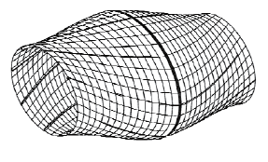
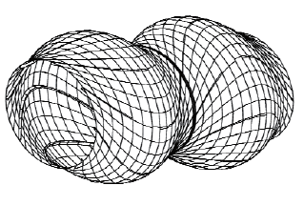

6. 1D Refined Model
PVD’s equation
Eigenvalue Problem

Slide 12

Advantages of 1D Refined Method…

Slide 13

Strong Points of 1D Refined Model
This method can be applied to beams and shell allowing to obtain the formulation of any structure without the need for ad hoc classical formulations.
Refined 1-dimensional LE models’ accuracy is comparable to 3D FEM models even if they require a much smaller number of DOFs.
13

Slide 14
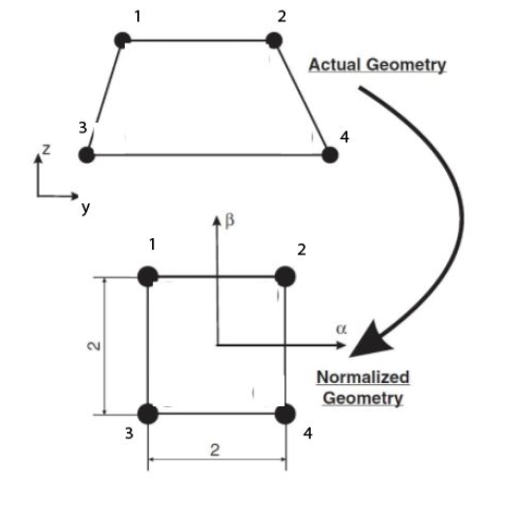
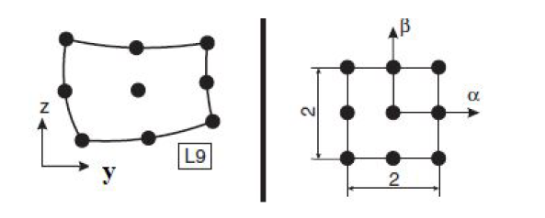
1 Lagrange Expansions
LE model variables and BCs can be located above the physical surfaces of the structure.
Locally refined models can be easily built since polynomials set can be arbitrarily spread above the cross-section.
_{Fig 4: LE4 and LE9 elements} ^{[6]Carrera, 2014}

Slide 15
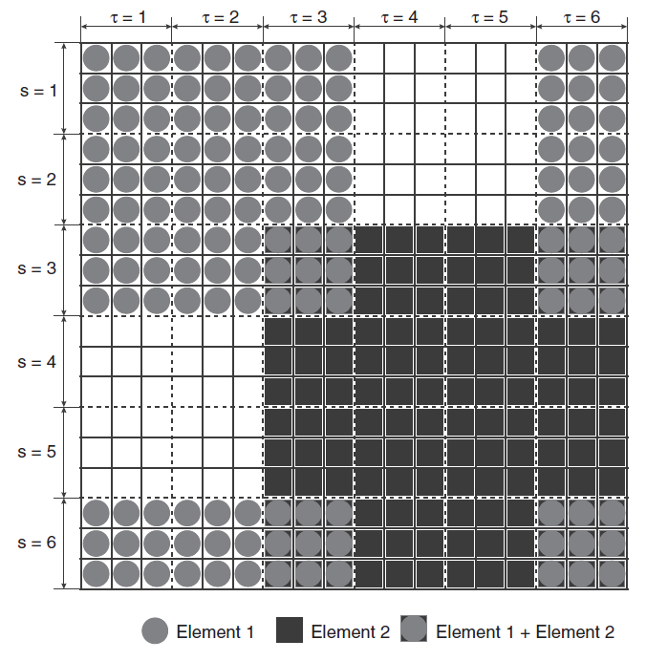
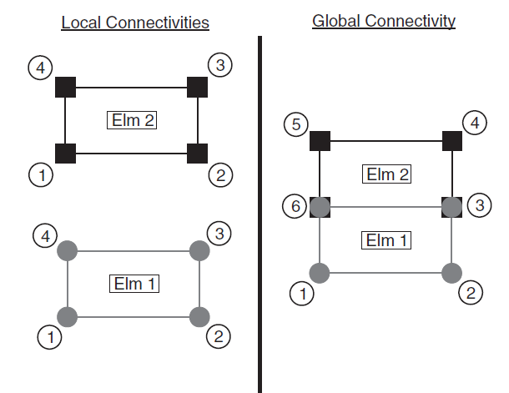

2. Lagrange Expansions
$$u(y,z)=F_{τ}\left(y,z\right)N_{i}\left(x\right)q_{iτ}$$
Fig5: An example of two L4 elements assembled within a beam model ^{[6]Carrera, 2014}
Fig6: Stiffness/mass matrix of single longitudinal node of a Beam element ^{[6]Carrera, 2014}

Slide 16
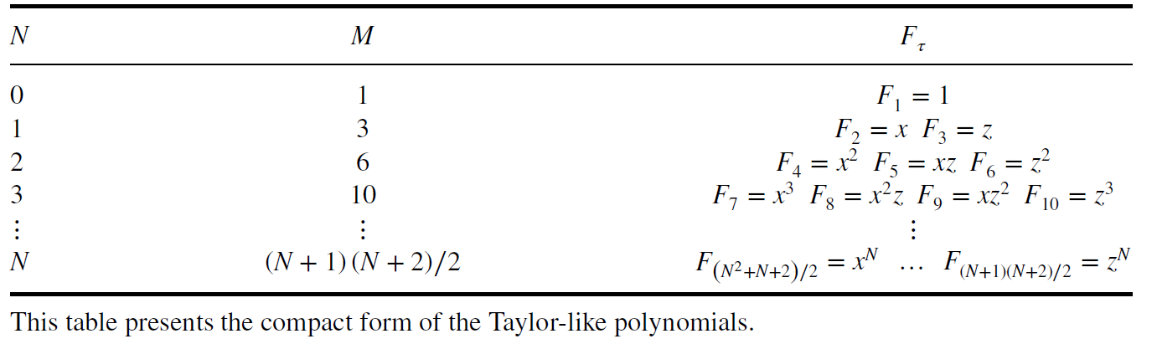
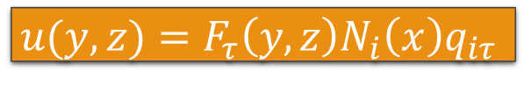
Taylor Expansions
$$u(y,z)=F_{τ}\left(y,z\right)N_{i}\left(x\right)q_{iτ}$$
CUF’s hypothesis

Slide 17
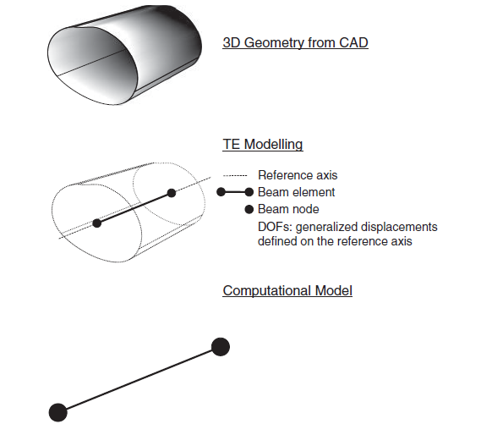
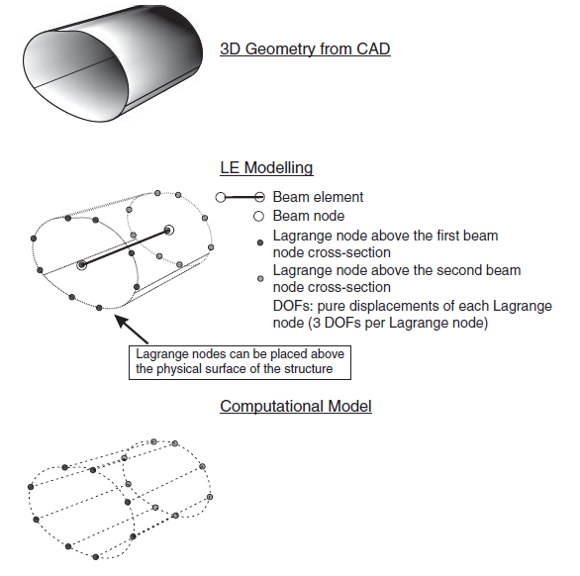
Taylor Lagrange

Slide 18

Numerical Results...

Slide 19
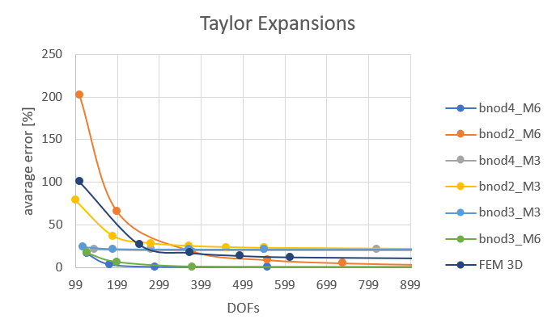
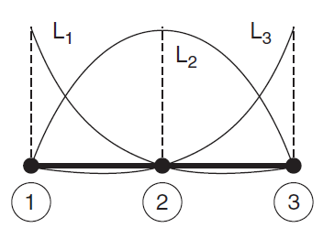
Convergence Taylor Expansions
Fig7: Results of Taylor method carried out for a square-section beam

Slide 20
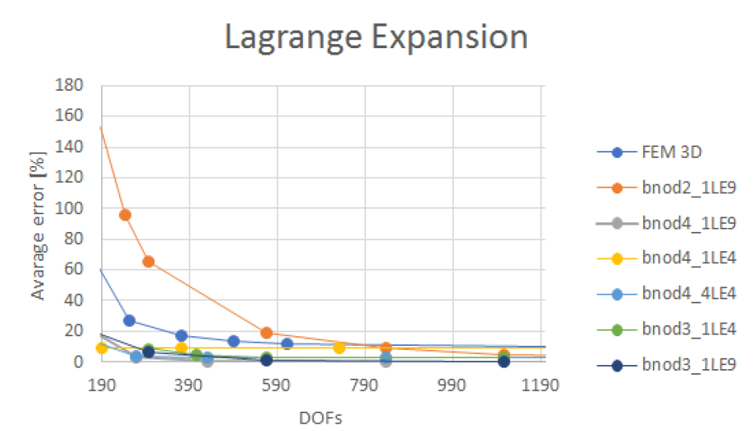
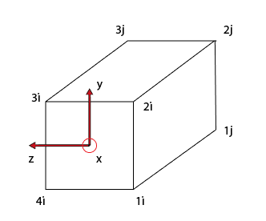
Convergence Lagrange Expansions
Fig9: Beam element (bnod2) when LE4 method is performed.
Fig8: Results of Lagrange method carried out for a square-section beam

Slide 21
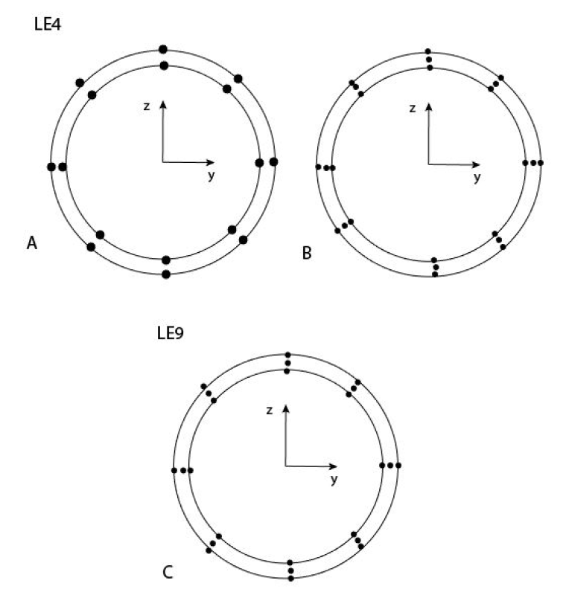
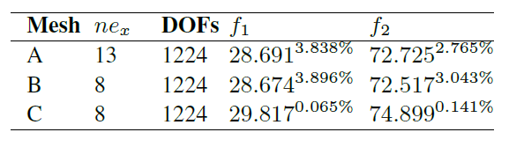
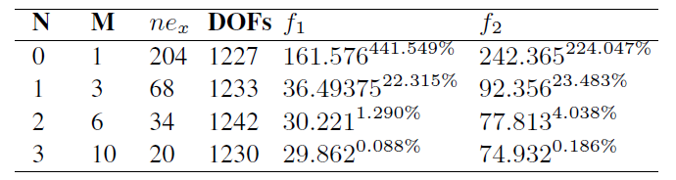
Thin-walled beam application
3D FEM
Tab1: Results through Lagrange expansions by using bnod3 Beam elements.
Fig10: Cross-section discretization for Lagrange method
Tab2: Results through Taylor expansions by using bnod3 Beam elements.

Slide 22
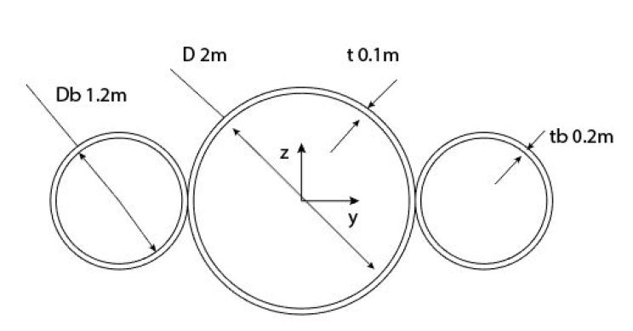
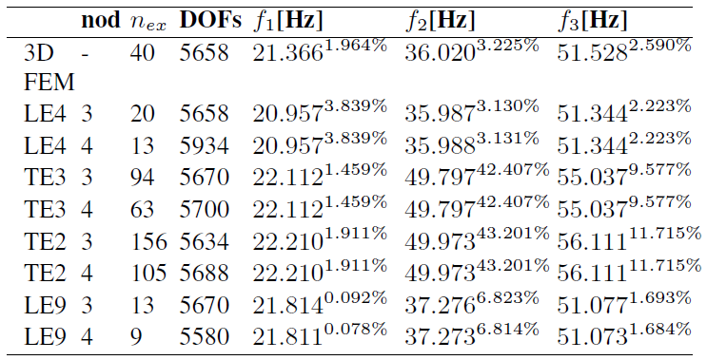
Launcher Application
Fig11: launcher’s cross-section
Tab3: First frequencies obtained by the 1D Refined Method and percentage errors

Slide 23
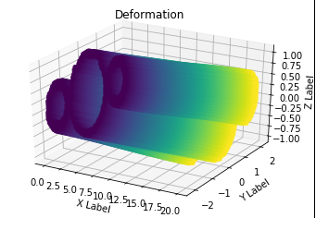
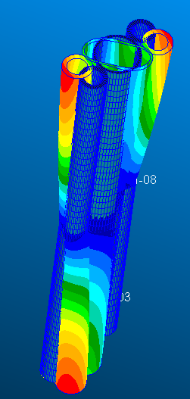
Launcher Application
Fig12: Launcher’s second free mode by 1D Refine Model implemented in Python
Fig13: Launcher’s second free mode by very refined meshed model in Nastran

Slide 24
Conclusions
Implementation of 1D Refined Method through Python Code
Several structures have been analyzed
Both Taylor and Lagrange Expansions were taken into account
Lagrange expansions provide results at least as accurate as Solid 3D FEM
Lagrange expansions are more convenient than Taylor expansions for thin-walled structure
Taylor expansions provide less accurate solutions than LE or 3D FEM when cross-section geometry is not simple

Slide 25

Thanks to…
Prof. Joseph MORLIER
Engineer Simone CONIGLIO
PHD Joan MAS COLOMER

Slide 26
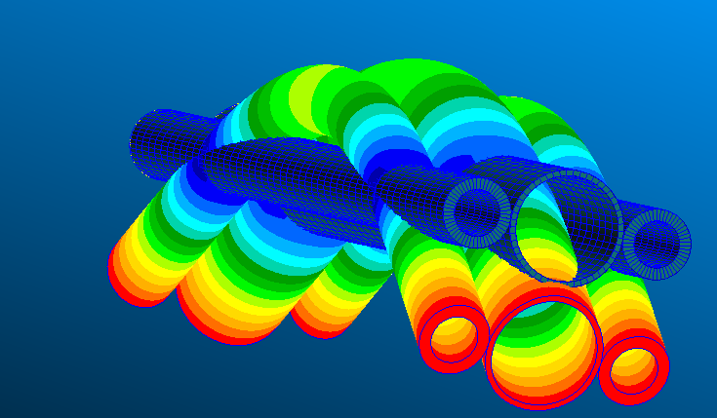
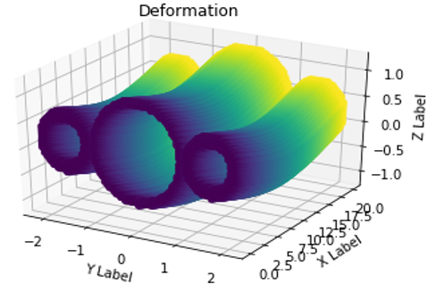
Thanks for your attention

Slide 27
References
[1] Przemieniecki, J.S., “Matrix structural analysis of substructures”, AIAA Journal, Vol.1, No.1, 1963, pp.138-147
[2] Hurty, W.C., “Dynamic analysis of structural systems using component modes”, AIAA Journal , Vol.3, No.4, 1965, pp 678-685.
[3] Friwell, M. and Mottershead, J.E., Finite Element Model Updating in Structural Dynamics.
[4] Carrera, “Theories and finite elements for multi-layered plates and shells: a unified compact formulation with numerical assessment and benchmarking”, Archives of Computational Methods in Engineering, Vol. 10, No.3, 2003, pp.216-296
[5] Carrera, E., Petrolo, M. And Nali, “Unified formulation applied to free vibrations finite element analysis of beams with arbitrary section”, Shock and Vibrations, Vol.18, No.3, 2011, pp. 485-502
[6] Carrera, E., Cinefra, M., Petrolo, M. and Zappino, E., Finite Element Analysis of Structures Through Unified Formulation, John Wiley & Sons, 2014
[7] Carrera, Enrico Zappino, Tommaso Cavallo,”Accurate Free Vibration Analysis of a Launcher Structures Using Refined 1D Models, International Journal of Aeronautical and Space Science, 2015

